Slide 1
“ Analysis on spotify most streamed songs of 2023 using statistical tools through software”.
Well, everyone wants to know what they played, right!!
- I mean statistical data guys!!

Slide 2
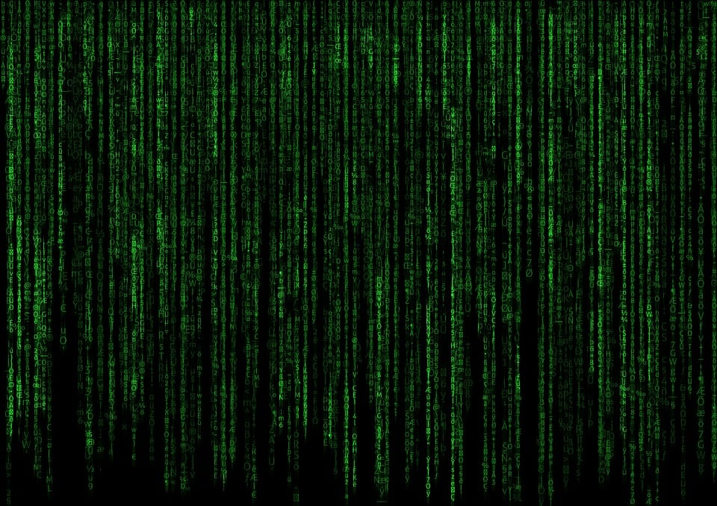
About the data:- This dataset contains a comprehensive list of most famous songs of 2023 as listed on spotify. Featuring track_name,artists_name,released_year,streams,bpm and so on.
Mainly focused features are the percentage of danceability,valence,energy,acousticness,intrumentalness,
Liveness and speechiness…

Slide 3
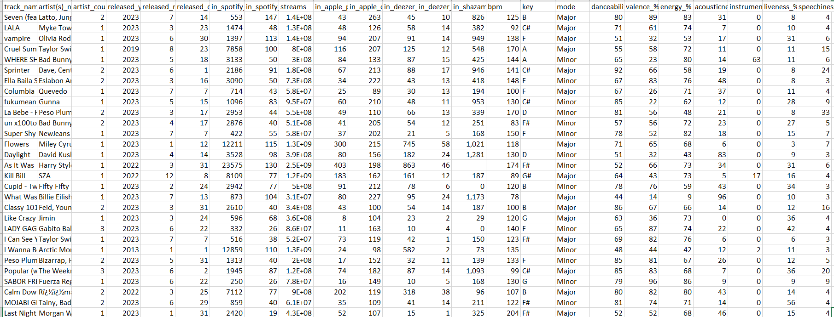
Here is the actual data feeded on the excel sheet:-

Slide 4
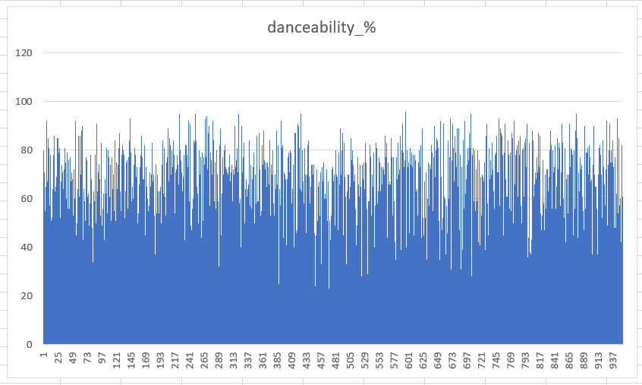
Charts:- Created bar charts for feature to show their distribution. This helps to understand the range and variability of the feature.

Slide 5
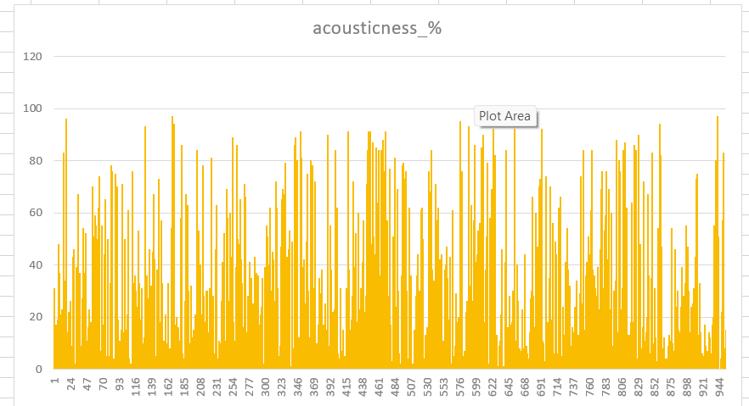
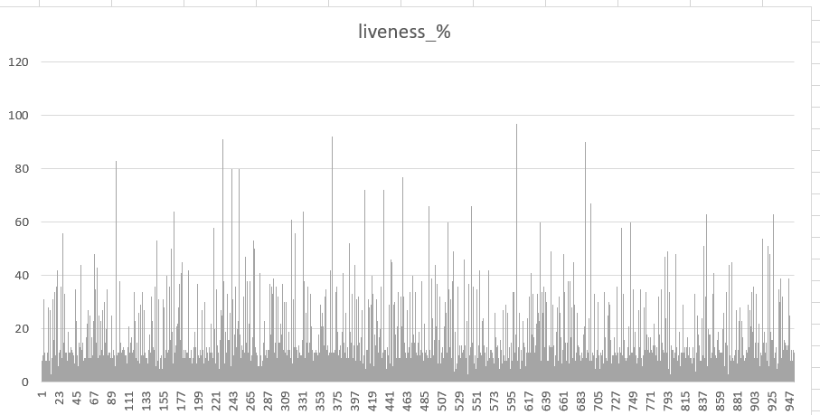

Slide 6
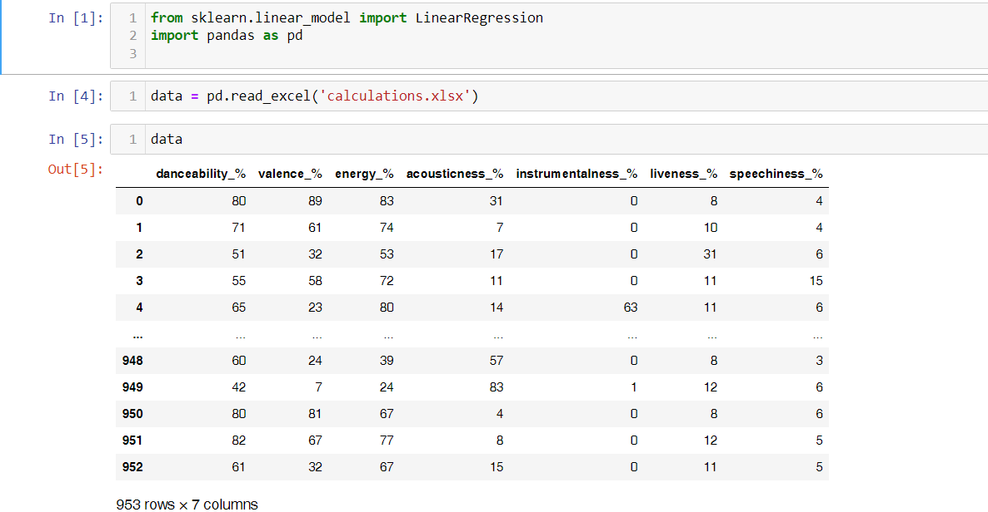
Tool 1:- Multiple regression using python

Slide 7
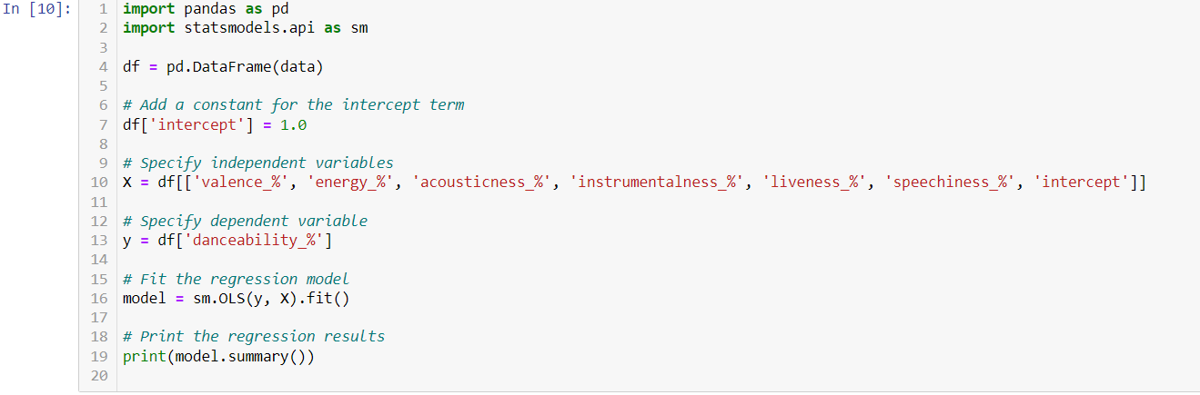
This is the code used to calculate multiple regression .

Slide 8
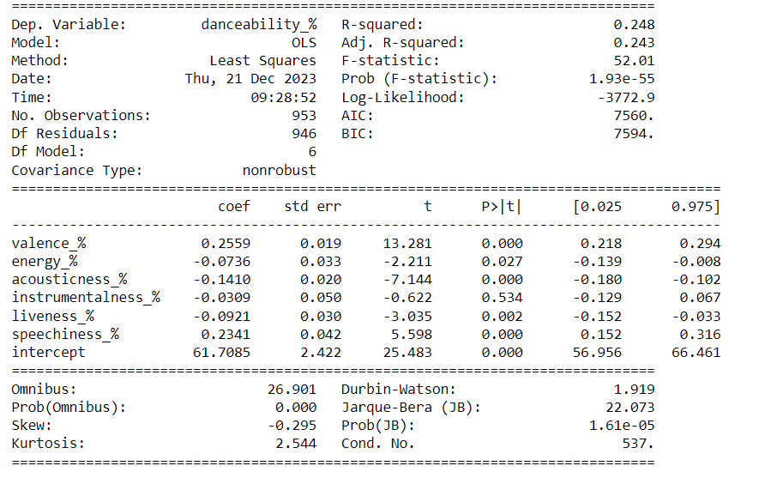
OUTPUT:-
Here the model suggests that there is some relationship between the independent variables and the dependent variables i.e. danceability_%.

Slide 9
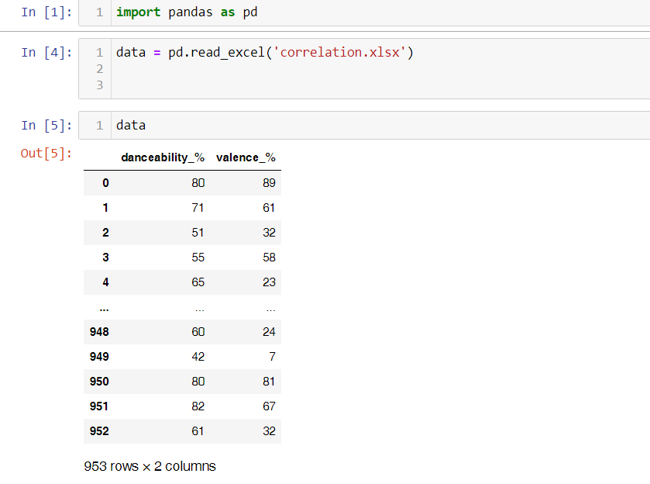
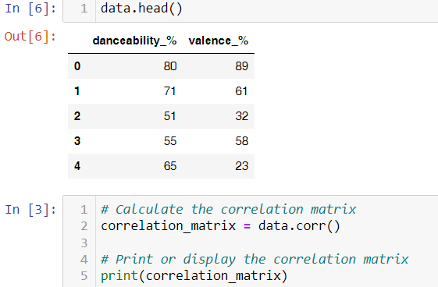
Tool 2:- Correlation using python:-

Slide 10

Output:-
Hence, There is a moderate positive correlation between danceability_% and valence_% also increase in danceability_% is associated with an increase in valence_%

Slide 11
Tool 3:- z-test two sample for means using excel:-
Setting the hypothesis:-
1. null hypothesis(H0):- There is no difference between the streams of single and multiple artists.
2. Alternative hypothesis(H1):- There is a difference between the streams of single and multiple artists.

Slide 12
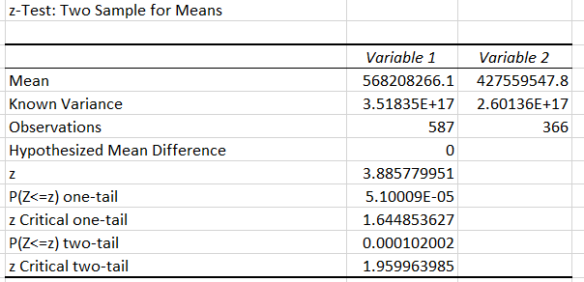
OUTPUT:-
The calculated z-statistic is 3.885779951, and both the one-tailed and two-tailed p-values are very small (close to zero).
Since the calculated z-statistic is greater than the critical values for both one-tailed and two-tailed tests, you would likely reject the null hypothesis.
This suggests that there is a significant difference between the means of Variable 1 and Variable 2.
That means there is a significant difference between streams of the single and multiple artists.
Also mean of the streams of single artists are more as compare to the mean of the streams of multiple artists.

Slide 13


